Slide 1
Scene-Based Text-to-Image Generation with Human Priors

Slide 2
“A picture is worth a thousand words” - Leonardo da Vinci
Heightened expressiveness of pictures over text
Existing text-to-image generation models lacks several pivotal aspects:
Controllability
Human perception
Quality and resolution

Slide 3
The proposed model addresses the pivotal gaps by
enabling a simple control mechanism complementary to text in the form of a scene
introducing elements that significantly improve the tokenization process by leveraging domain-specific knowledge across key image regions (faces and salient objects)
adapting classifier-free guidance for the transformer use case

Slide 4
Overview of proposed method comprises of:
Scene representation and tokenization
Attending human preference in the token space with explicit losses
Scene-based transformer
Transformer classifier-free guidance

Slide 5
Scene representation and tokenization
Scene is made up of 3 semantic segmentation groups that are complementary to each other:
Panoptic
Human
Face
Semantic layout provides additional global context that correlates with human preference
Both text and scene firmly control the image generation

Slide 6
Adhering to human emphasis in the token space
An inherent upper-bound on image quality when generating images with transformer, due to the tokenization reconstruction process
Modifications to both segmentation and image reconstruction methods were introduced
These modifications are losses in the form of support (specific region awareness) and perceptual knowledge (feature-matching over task-specific pretrained networks)

Slide 7
Face-aware vector quantization
The model uses
Feature-matching loss to introduce “awareness” of face regions
Additional visual information into the activations of a pre-trained face-embedding network
Prompts high-quality face reconstruction

Slide 8
Face emphasis in the scene space
The model
applies a weighted binary cross-entropy face loss to the segmentation face parts classes, emphasizing higher importance for face parts
includes face parts edges in the semantic segmentation edge map
Object-aware vector quantization

Slide 9
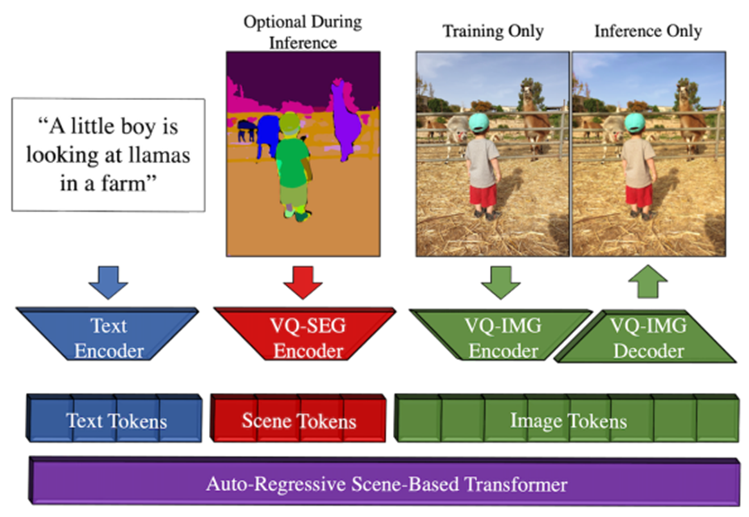
Scene-based transformer:
Given an input text and optional scene layout, a corresponding image is generated
Transformer generates the relevant tokens, encoded and decoded by the corresponding networks

Slide 10
Transformer classifier-free guidance:
Classifier-free guidance is the process of guiding an unconditional sample in the direction of a conditional sample

Slide 11
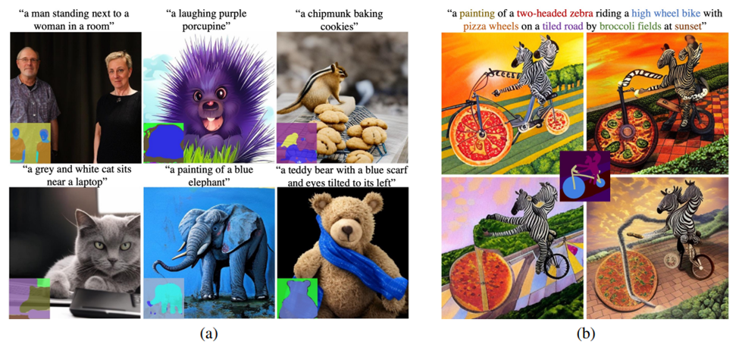
Additional Model capabilities
Complex scene generation

Slide 12
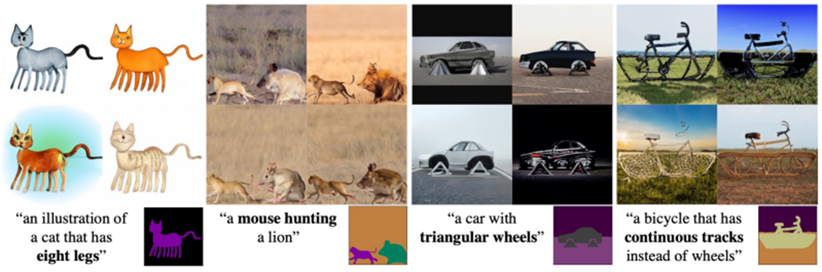
2. Generating images with out-of-distribution text prompts

Slide 13
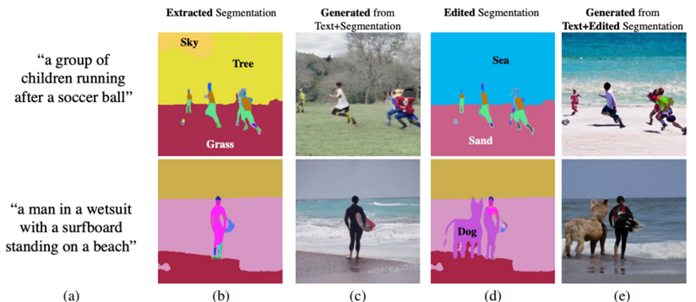
3. Generating images through edited scenes

Slide 14
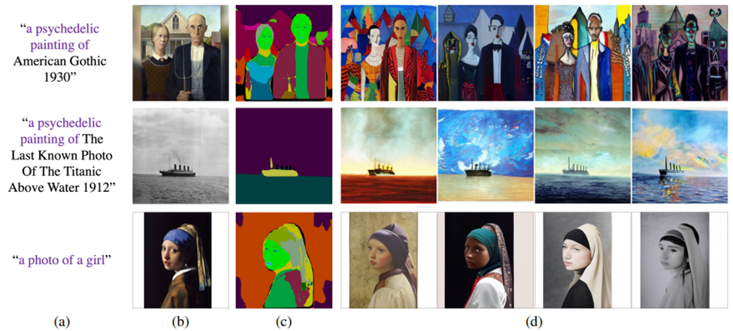
4. Text editing and anchor scenes

Slide 15
Conclusion
Text-to-image methods aims
improving the general quality
adherence to text of generated images
Proposed model provides more interactive experience with control over the generated outputs

